Slide 1
Bee Beautiful
Submitted by: Bijaya Malla Thakuri
LCID: LC00017001156

Slide 2
Table of Content
Introduction of the Project
About the Problem
Objective of the project
Scope of the project
Working Methodology
Hardware and Software used
Listing out the Testing Technologies
Limitations of the system
Conclusion

Slide 3
Introduction of the Project
Bee Beauty is a organic skincare refers to the use of products made from natural, non-synthetic ingredients that are grown and processed without the use of synthetic chemicals, pesticides, or genetically modified organisms (GMOs).
Our skincare product reveals the untold radiance and beauty of your skin, guiding you to a journey of revitalization and glow. Bee Beautiful Ecommerce Application – a platform dedicated to providing a curated selection of premium organic skincare products that not only pamper your skin but also reflect your commitment to self-care and sustainability. Join us on this journey to discover the transformative power of nature's goodness, right at your fingertips.

Slide 4
About the Problem
The absence of a robust selection of organic skincare products has led to several pressing issues within the skincare industry and among consumers. These problems highlight the urgency for a solution like our Organic Skincare Ecommerce Application:
Health Concerns: Conventional skincare products often contain harmful chemicals, synthetic fragrances, and additives that can lead to skin irritations, allergies, and even more serious health issues over time. The lack of accessible organic alternatives exacerbates these health concerns.
Environmental Impact: Many non-organic skincare products are manufactured using processes that contribute to environmental degradation. The absence of organic options has resulted in the continued use of ingredients that harm ecosystems during production and disposal.

Slide 5
Objective of the project
Some objectives are mentioned below:
Ensure customers have access to a diverse range of effective and safe options.
Prioritize the well-being of customers by providing skincare products free from harmful chemicals, promoting healthier skin and reducing the risk of allergies and irritations.
Build consumer trust by providing clear product information, ingredient lists, and certifications, enabling customers to make informed decisions about the organic authenticity of the products they purchase

Slide 6
Scope of the project
The application aims to provide a comprehensive platform for purchasing, learning about, and engaging with a diverse range of premium organic skincare products.
The application offers a wide array of ethically sourced and environmentally friendly organic skincare products, fostering a community of conscious consumers.

Slide 7
Working Methodology
The Agile model is an approach used in software development and project management. It’s like building something step by step, getting feedback along the way, and making improvements as you go.
Agile breaks the work into smaller parts called “sprints”. Each sprint is a short period, like a week or two, where you focus on creating a specific part of the project. You build, test, and improve that part before moving on to the next.
Planning
Requirements Analysis
Design
Building
Unit Testing
Acceptance Testing

Slide 8
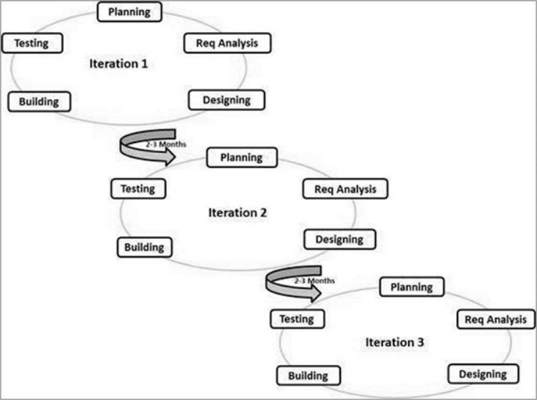
Here is a graphical illustration of the Agile Model:

Slide 9
Hardware and Software used
Hardware used:
Processor : Intel CORE i5
RAM : 8.00 GB
SSD : 228 GB
HDD : 1TB
Software used:
Visual Studio Code
Frontend
React
Backend
Django

Slide 10
Listing out the Testing Technologies
Unit testing
System testing
Integration Testing
Acceptance Testing

Slide 11
Limitations of the system
: The application's availability is subject to the geographic reach of product suppliers and may not cover all regions equally, potentially limiting access for some customers.
The application's reliance on digital interaction may hinder the ability to physically experience or test products before purchase, impacting the decision-making process for some users.

Slide 12
Conclusion
Organic skincare involves utilizing naturally derived ingredients free from synthetic chemicals and pesticides to promote skin health. By embracing these holistic and environmentally friendly practices, individuals can nurture their skin while minimizing potential harm to themselves and the planet

